Slide 1

School of Computing Science and Engineering
Course Code : BCS01T1003 Name: Computer Programming for Problem Solving-C
UNIT III
ARRAYS AND FUNCTIONS
ARRAYS
Name of the Faculty: Dr. Saumya Chaturvedi Program Name : B.Tech(CSE)

Slide 2
Objective
What is an Array
Why we need an Array in C programming
How to declare an Array in C
How to access elements of an Array
How to initialize an Array
Program Name: B.Tech (CSE)

Slide 3
C Arrays
An array is a data structure in C programming, which can store a fixed-size sequential collection of elements of the same data type.
An array in C is a collection of items stored at contiguous memory locations and elements can be accessed randomly using indices of an array.
Arrays can be used to store collection of primitive data types such as int, float, double, char, etc of any particular type.
so we can say that an int array holds the elements of int data types while a float array holds the elements of float data types.
Program Name: B.Tech (CSE)

Slide 4
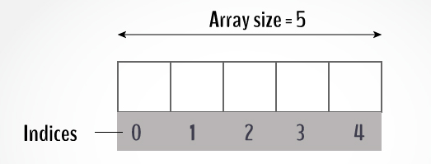
Pictorial Representation of Array
Program Name: B.Tech (CSE)

Slide 5
Why we need Arrays ?
Consider a scenario where you need to find out the average of 100 integer numbers entered by user.
In C, you have two ways to do this: 1) Define 100 variables with int data type and then perform 100 scanf() operations to store the entered values in the variables and then at last calculate the average of them
2) Have a single integer array to store all the values, loop the array to store all the entered values in array and later calculate the average.
Which solution is better according to you? Obviously the second solution, it is convenient to store same data types in one single variable and later access them using array index
Program Name: B.Tech (CSE)

Slide 6
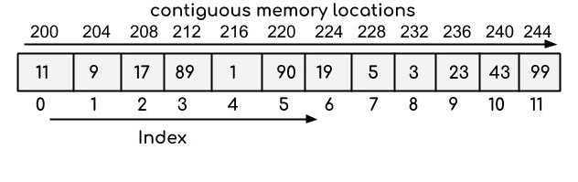
Array Memory representation
The following diagram represents an integer array that has 12 elements. The index of the array starts with 0, so the array having 12 elements has indexes from 0 to 11.
Program Name: B.Tech (CSE)

Slide 7

How to declare an Array
To declare an array in C, you have to specify the type of the elements and the number of elements required by an array as follows −
For example, int data[100];
Here, we declared an array, data, of integer type. And its size is 100. Meaning, it can hold 100 integer values.
It is important to note that the size and type of an array cannot be changed once it is declared.
Program Name: B.Tech (CSE)

Slide 8
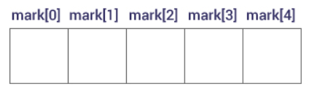
Access Array Elements
You can access elements of an array by indices.
Suppose you declared an array float mark[5];
The first element is mark[0], the second element is mark[1] and so on.
Few keynotes:
Arrays have 0 as the first index, not 1. In this example, mark[0] is the first element.
If the size of an array is n, to access the last element, the n-1 index is used. In this example, mark[4]
Suppose the starting address of mark[0] is 2120d. Then, the address of the mark[1] will be 2124d. Similarly, the address of mark[2] will be 2128d and so on.
This is because the size of a float is 4 bytes.
Program Name: B.Tech (CSE)

Slide 9
How to initialize an Array
It is possible to initialize an array during declaration. For example,
int mark[5] = {19, 10, 8, 17, 9};
You can also initialize an array like this.
int mark[] = {19, 10, 8, 17, 9};
Here, we haven't specified the size. However, the compiler knows its size is 5 as
we are initializing it with 5 elements.
Program Name: B.Tech (CSE)

Slide 10
Change value of an Array element
Suppose we have array mark as int mark[5] = {19, 10, 8, 17, 9}
Now if we want to make the value of the third element to 12, then we will write
mark[2] = 12;
To make the value of the fifth element to 0 we will write
mark[4] = 0;
Program Name: B.Tech (CSE)

Slide 11
Summary
Array can store a fixed-size sequential elements of the same data type.
Items stored at contiguous memory locations and elements can be accessed randomly using indices.
The index of the array starts with 0
The size and type of an array cannot be changed once it is declared.
Program Name: B.Tech (CSE)

Slide 12
References
E. Balagurusamy 7th Edition, Programming ANSI C, McGraw-Hill
Brian W. Kernighan and Dennis M. Ritchie, The C programming Language, Prentice-Hall in 1988
Byron Gottfried, Programming with C, Schaum's Outline
Program Name: B.Tech (CSE)

Slide 13
Contact Information
Dr. Saumya Chaturvedi
saumya.chaturvedi@galgotiasuniversity.edu.in
Program Name: B.Tech (CSE)

Slide 14


